Slide 1
Edinburgh Business School MBA
AUC Academic Partner
Strategic Planning
Cases
Instructor: Moataz Darwish, MBA

Slide 2

Introduction
  The strategist has to think more widely and deeply than the individual functional specialists.
  This is an extremely difficult game to play and it goes without saying that unless you practice you will never get into the top right hand box of Strategic thinking.
EBS MBA / AUC

Slide 3
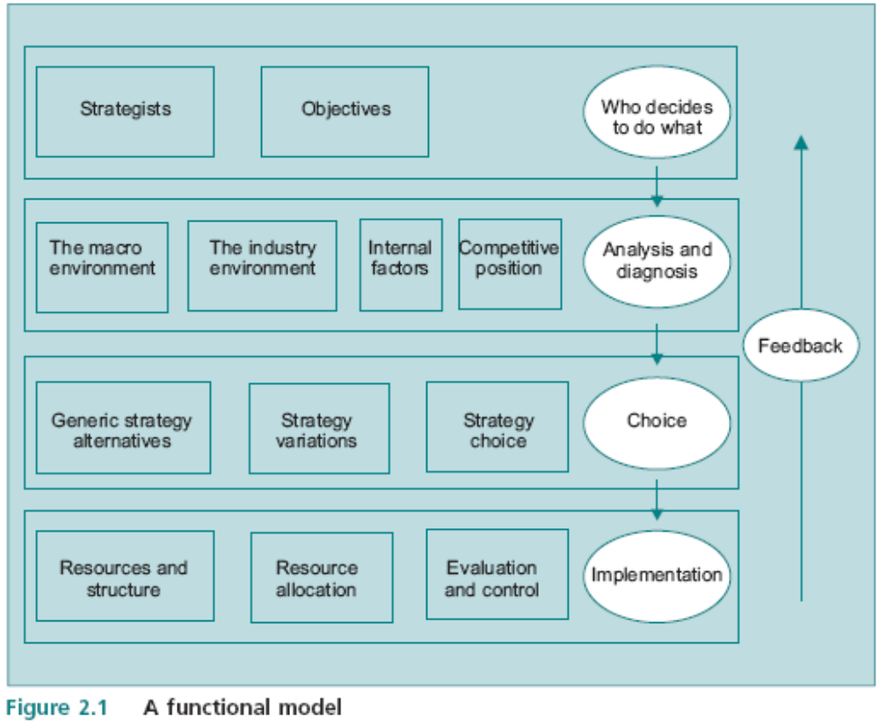
The SP Model
4 rows
5 eggs
12 boxes
EBS MBA / AUC

Slide 4
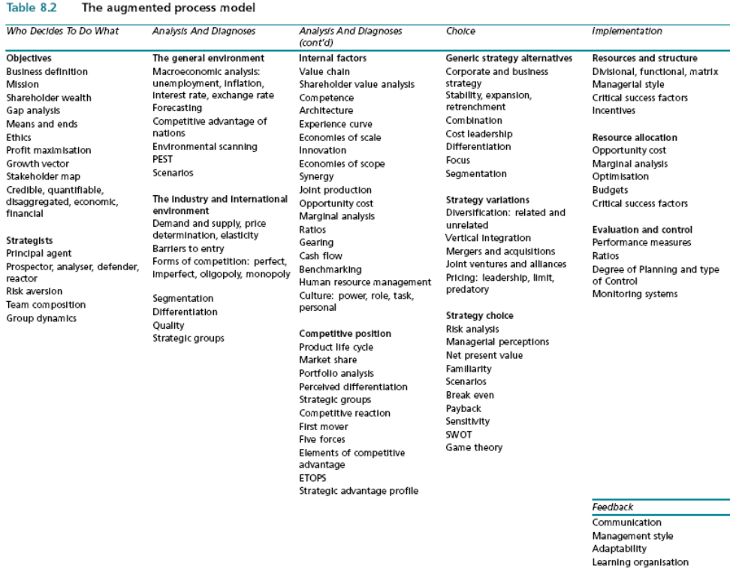
The Augmented Process Model
EBS MBA / AUC

Slide 5
Augmented Model - summary
Who Decides To Do What
Analysis And Diagnoses
Analysis And Diagnoses
Choice
Implementation
OBJECTIVES
Business Definition
Mission
Shareholder wealth
Gap analysis
Means and ends
Ethics
Profit maximisation
Growth vector (Ansoff)
Stakeholder map
Credible, quantifiable,
disaggregated, economic,
financial
STRATEGISTS
Prospector, analyzer, defender, reactor
Principal agent
Risk aversion
Team composition
Group dynamics
Corporate Governance
THE GENERAL ENVIRONMENT
Macroeconomic analysis:
unemployment, inflation,
interest rate, exchange rate
Forecasting
Competitive advantage of
nations
Environmental scanning
PEST
Scenarios
The industry and international
environment
Demand and supply, price
determination, elasticity
Barriers to entry
Forms of competition: perfect, imperfect, oligopoly, monopoly
Segmentation
Differentiation
Quality
Strategic groups
INTERNAL FACTORS
Value chain
Shareholder value analysis
Competence (resources/routines matrix)
Architecture
Experience curve
Economies of scale
Economies of scope
Innovation
Synergy
Joint production
Opportunity cost
Marginal analysis
Ratios
Gearing
Cash flow
Benchmarking
Human resource management
Culture: power, role, task,
personal
Competitive position
Product life cycle
Market share
Portfolio analysis (BCG)
Perceived differentiation
Strategic groups
Competitive reaction
First mover
Five forces
Elements of competitive adv
ETOPS
Strategic advantage profile (SAP)
GENERIC STRATEGY ALTERNATIVES
Corporate and business
strategy
Stability, expansion,
Retrenchment, Combination
Cost leadership, Differentiation, Focus
Segmentation
Strategy variations
Diversification: related and
Unrelated (Fam Matrix)
Vertical integration
Mergers and acquisitions
Joint ventures and alliances
Pricing: leadership, limit,
predatory
Strategy choice
Risk analysis
Managerial perceptions
Net present value
Familiarity
Scenarios
Break even
Payback
Sensitivity
SWOT
Game theory
RESOURCES AND STRUCTURE
Divisional, functional, matrix
Managerial style
Critical success factors
Incentives
Resource allocation
Opportunity cost
Marginal analysis
Optimisation
Budgets
Critical success factors
Evaluation and control
Performance measures
Ratios
Degree of Planning and type
of Control
Monitoring systems
FEEDBACK
Communication
Management style
Adaptability
Learning organisation

Slide 6
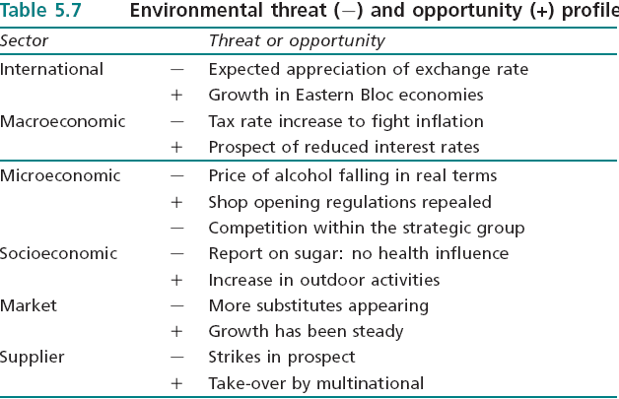
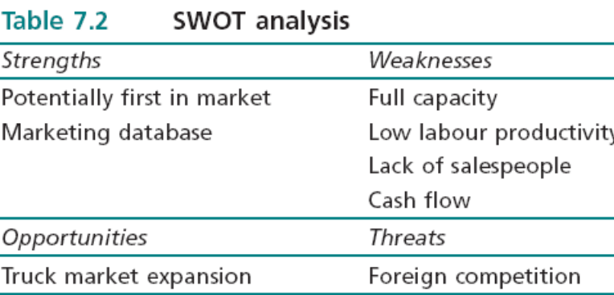
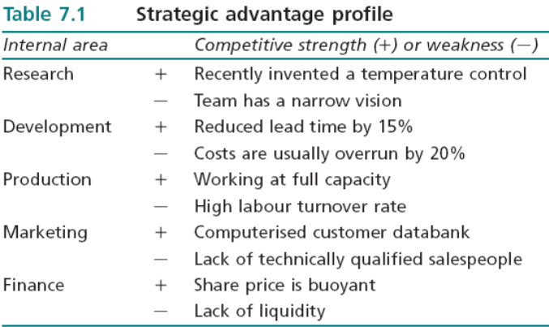
Objective –> Strategy -> Recommendations
Environmental/Industry/Internal Scanning
ETOP
SWOT
SAP

Slide 7
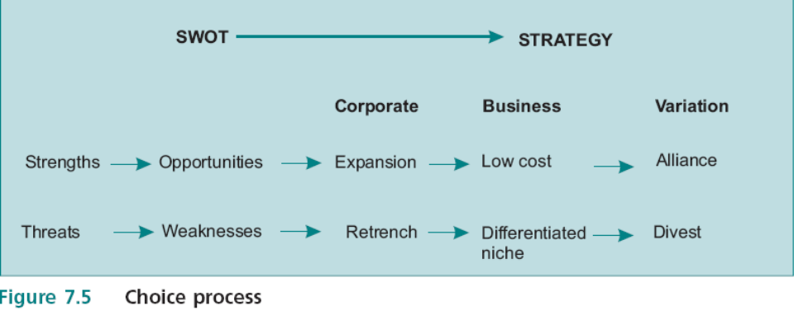
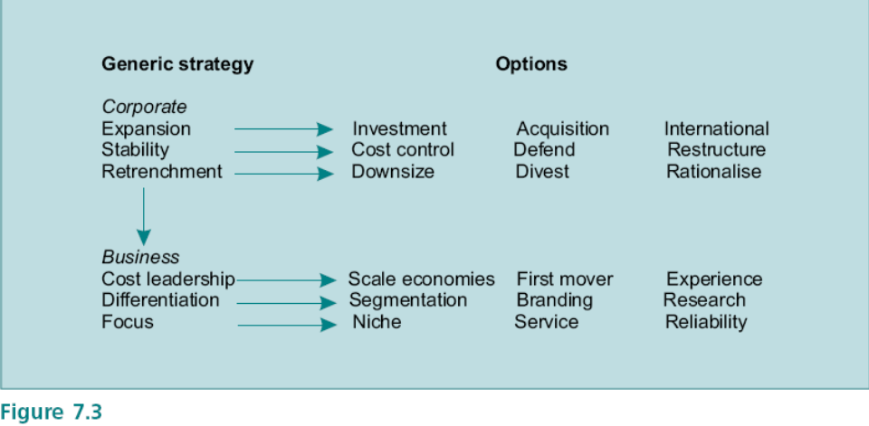
SWOT to Strategy
ETOP
Short term
Corporate
SBU
Ex. Cost/mkt share/efficiency
SWOT
SAP
Long Term
Corporate
SBU
Ex. Move along Ansoff matrix
In strategic terms the distinction is between actions that are intended to deal with immediate issues (short term), such as reducing cost to avoid bankruptcy, rather than those that deal with the basis on which the company competes, such as building competences, developing a portfolio and adjusting market position to generate competitive advantage (Long term). There is often a conflict between the need to deal with the immediate imperatives and building long term competitive advantage; this can be a permanent feature of companies in a volatile environment in which there is a continual need to make trade offs.

Slide 8
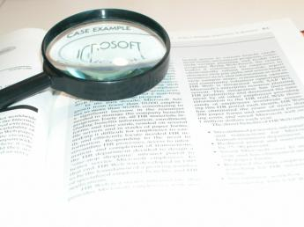
SP Exam
Question 1: Data Based Case (1/3 of the exam grade)
Question 2: Real Life Case (1/3 of the exam grade)
  Identify what the story is about - success/failure/new venture…etc
  Identify reasons/causes (ex. for the failure…)
Question 3: Essay (1/3 of the exam grade)
  Present a balanced argument (for and against)
  Arrive to conclusion backed w/ argument
  Plenty of opportunities to incorporates ideas
EBS MBA / AUC

Slide 9
Exam Tips
No right and wrong
Read the question first
Put things in order (STUCTURE) - note taking (closet organizer),
(Case →Model → Tools->Analyses->conclusion)
Don’t simply mention the tool/concept…APPLY IT
Explain WHY you’re applying a certain tool/concept
Make use of ALL data…it’s there for a purpose
Leave space after every case and sub-sections of the model to revisit if possible
Have a go at ALL Questions and ALL PARTS of Questions
Watch out for comparisons in the single case (between 2 periods, 2 companies…), that would entail duplicating the model structure of both.
Do not panic because you have not completely filled in the answer book; we are looking for good quality applications and reasoned arguments.
EBS MBA / AUC

Slide 10
Exam Tips
Examination grading
Each of the three questions in the examination carries equal weighting.
Usually each question consists of more than one part, but marks are not specifically awarded to each individual part.
This is because there is often a degree of overlap among different parts and the examiner takes an overall view of how the question was answered.
Obviously if part of a question is not tackled, the mark will be downgraded.
Finally, the examination paper as a whole is evaluated in terms of its analytical content, the application of strategic concepts, any insights and the quality of the arguments; in marginal cases, the decision is made on the basis of overall content rather than simply taking the sum of the marks on the three questions.
Long vs. short term (see notes below)
EBS MBA / AUC
Notes:
The short run and long run
In most of the cases there is a point when you ask us to make suggestion on long-term and short-term actions for a company by applying the SWOT matrix. Can you distinguish between long term and short term? As I see, the long-term actions are concerned mostly with generic strategy issues both on business level and corporate level, but can you help me regarding short-term actions?
The treatment of short and long run in the strategy literature is typically confused. The following is an extract from a paper I recently produced that addresses this issue.
There are several operational definitions of the short and long run in the strategic context; for example, the difference can be expressed in terms of the time period in which performance is measured: the short term could be profitability targets in the next two years while the long run could be profitability on a recurrent basis over a five year horizon. But this type of definition is arbitrary and actually misses the point: the difference is one of type rather than of time period. In economics the terms have particular meanings that are not related to actual time periods, i.e. the short run is the period in which only one factor of production varies, while in the long run all factors are variable; this distinction is essential for understanding ideas such as economies of scale. In strategic terms the distinction is between actions that are intended to deal with immediate issues, such as reducing cost to avoid bankruptcy, rather than those that deal with the basis on which the company competes, such as building competences, developing a portfolio and adjusting market position to generate competitive advantage. There is often a conflict between the need to deal with the immediate imperatives and building long term competitive advantage; this can be a permanent feature of companies in a volatile environment in which there is a continual need to make trade offs. It greatly complicates the pursuit of competitive advantage because the long run objective is continuously obscured by immediate concerns; this is one reason why many organisations find it difficult to ‘think strategically’.

Slide 11
Case Study Analyses
Put things in order – note taking – closet organizer
Case
Relate to
Break down to
Deduct
Paragraphs
Model
Tools
Analyses
Matrices
Key (Buzz)
words
Concepts
EBS MBA / AUC

Slide 12
‘Focus on Nestlé’ Case
Question 2, Jun 07 Exam
Required:
1. What changes to the strategic process in Nestlé did Mr Brabeck introduce after taking over from Mr Maucher?
2. There is some doubt on future strategic moves. Set up a SWOT analysis and advise Mr Brabeck on a course of action.
EBS MBA / AUC

Slide 13
Active-Reading Methodology - Nestlé’ Case
Objective->Name+what industry?
By 2004 Nestlé, a Swiss food and drink group,
was by far the biggest in its sector.
For twenty years, Nestlé had been growing through
a series of acquisitions and new market entries,
but its CEO, Mr Brabeck, still had plans to
maintain or even increase its rate of growth.
In order to do so he recognized that he would
have to transform Nestlé from being a group of
Unrelated businesses into an efficient and coordinated operation.
Implementation->org str
Industry/Internal->Mkt share
Past objective -> growth
Past Strategy->expansion-> >Acq+mkt entry->Ansoff?
Strategist->Defender?
Objective->profitability?
Strategy->stabilization?
Strategy->from unrelated diversification to
internal efficiency through change mgt
-> from expansion to stabilization?
EBS MBA / AUC

Slide 14
Exercise
Please practice the active-reading methodology for the rest of the case and solve the case accordingly.

Slide 15
Nestlé’ Case
A major difference between Mr Brabeck and His competitors is the approach to growth.
While Nestlé was expanding, most of the other big companies in the sector either shrank or remained stable. For example, between 2000 and
2004, Unilever cut its workforce by 14%, closed 100 factories, and reduced its brands from 1600
to 400. In 2003, Cadbury announced the closure of 25 factories and a 10% reduction in the
workforce. Yet while Nestlé kept growing, its profit margins lagged behind those of its major
competitors. It has been argued that Nestlé should have returned cash to shareholders rather
than using it to fund growth but, on the other hand, between 1975 and 2004, Nestlé’s share
price rose by about three times the S&P index.
The growth trail
Nestlé’s current growth trajectory began under Mr Brabeck’s predecessor, Mr Maucher, who took
over in 1981 after Nestlé had made a misguided expansion into hotels and restaurants. Mr
Maucher sold off the unprofitable businesses and decided that Nestlé would focus on mineral
water,ice cream, pet food and confectionery. In 1988, Mr Maucher bought Rowntree, famous for
Kit Kat and Smarties, and in 1992 Perrier; he also purchased the market dominant ice cream
makers in Spain, Australia and Canada. When he took over in 1997, Mr Brabeck continued
buying, culminating in 2001 with the purchase of Ralston Purina, a US pet food company, for $10
billion; this made Nestlé one of the two biggest pet food makers in the world.
EBS MBA / AUC

Slide 16
Nestlé’ Case
Mr Brabeck versus Mr Maucher
The two CEOs initially appeared to have a similar approach and issued a circular setting out what
would not change under Mr Brabeck. There were two ‘unique’ features they wished to preserve:
first, IT would not be important in the day to day running of Nestlé because the focus was on its
people, products and brands; second, the commitment to decentralisation would remain to
cater to local tastes and maintain emotional links with distant clients.
But within two years Mr Brabeck recognised that these ‘unique’ features were not contributing to
competitive advantage. Decentralisation was abandoned with the establishment of SBUs
dealing with similar products. But this was resisted by many managers who did not want to
lose their independence; the result was a management shake-out. But Mr Brabeck was now
faced with a conundrum. Companies such as Danone, which focused only on water, diary
products and biscuits, were doing better than Nestlé. So the question had to be faced whether
focus was necessary in the food industry. At the same time, the attempt to transform Nestlé into a
global business ran the risk of losing the ability to adapt to local conditions. For example, there are
200 varieties of Nescafé, the instant coffee brand. Mr Brabeck turned his attention to cost cutting
and efficiency and closed 150 under-performing factories; he also aimed to reduce administrative
costs by 1% by 2006. In 2000, Mr Brabeck June 2007launched the ‘Global Business Excellence’ project
with SAP, a German software company, to develop a company wide resource planning
system which will be based on one technology platform providing more accurate information on
raw materials and stock levels. This standardisation is necessary because different
versions of software are in use because of the legacy from acquisitions. There was no
coordination in purchasing, resulting in Nestlé paying 20 different prices for vanilla to the same
supplier. In some regions, such as the US and Asia, steps have already been taken to
standardise systems with considerable success. But whether this can be made to work at a global
level remains to be seen. It had not taken Mr Brabeck long to dispense with
the two ‘unique’ features. But some analysts claim to have been puzzled that Mr Brabeck
signed up to those in the first place, and that he was now acting in the same way as other CEOs of
big complex companies.
EBS MBA / AUC

Slide 17
Nestlé’ Case
Some lurking issues
There is some doubt as to how long it will take to make the new resource planning system fully functional. The initial
prediction was for 2006, revised to 2007, and some analysts doubt whether it will be running before 2010. This will
inevitably delay the full transformation of Nestlé that Mr Brabeck needs to compete effectively. Nestlé is so well known that
it is exposed to a high level of reputational risk. In the 1970s, Nestlé was involved in a scandal that it has never
shaken off over sales of baby-milk formulae in poor countries. In 2002, Nestlé made a blunder by trying to extract payments
from Ethiopia, which at the time was impoverished. Continuing efforts are directed at maintaining Nestlé’s reputation which
is essential for a food company; the consumer complaints hotlines follow up every complaint; also, every year some products
are withdrawn. The obesity epidemic has forced Nestlé to reconsider its image and Mr Brabeck is attempting to reposition
Nestlé as a ‘food, nutrition, health and wellness’ company. A new Nutrition division has been created that produces
clinical nutrition, performance nutrition and baby food. Nestlé is now selling a ‘new nutritional message’ that food provides
health benefits rather than making people fat. By 2004, Nestlé had introduced 600 new or reformulated products in 50
countries by adding minerals and vitamins to products such as yogurt and ice cream. But there is no guarantee of success
even in the new health conscious climate. For example, the new line of yogurts, LC1, that is meant to improve the
immune system and digestion, failed in several European countries in the face of competition
from a similar product Actimel, produced by Danone. The push into new markets is continuing, and
Nestlé is willing to enter countries such as Iraq and Iran so long as there is a free market, a large
enough population, and a welcome for foreign investors. The result was that organic growth
(excluding acquisitions) from 1999 to 2003 was 5.7% compared with 2.7% for Unilever; but there
are significant risks associated with entering new and untried markets.
Any attempt to grow further by acquisition is likely to cause problems with antitrust laws.
There is also the problem that existing portfolios do not often fit; for example, if Nestlé went
ahead with a potential acquisition of General Mills it would probably have to sell off about half the
business. Nestlé still has some non-core businesses. It has major ownership of Alcon, an ophthalmological equipment maker,
and L’Oréal, the French cosmetics company. It has been rumoured that Nestlé is considering acquiring total ownership of
L’Oréal and producing innovative nutritional cosmetic products. The big issue is whether Mr Brabeck will make any further acquisitions before Nestlé transforms itself into an effective global company with strong controls and a low cost base.
EBS MBA / AUC

Slide 18
Case 3 - June 2008
Question 3
The CEO of a large multinational diversified company was concerned that profitability had been falling for the previous two years and that the company had not been exploiting opportunities effectively. He employed two famous management consultants to provide independent remedies and they provided two completely different sets of recommendations. One focused on the need to reduce the management structure (delayering) and improve internal communications; the other criticised product positioning and the composition of the product portfolio. Each was supported by highly convincing arguments. The CEO asked you to help choose between them. Your response was that there was no scientific basis for choosing between them and, depending on their impact on the strategic process, it may be advisable to apply both.
Why is it impossible to produce scientifically acceptable evidence that either of the approaches is correct?
Demonstrate the potential impact of the two sets of recommendations on the strategic process. Is it advisable to apply both?

Slide 19
Case 3 - Dec 2007
Question 3
A major multinational had announced losses for the first time ever, primarily due to poor performance in 7 out of 15 Divisions. The non-executive Board members had met to decide on the fate of the CEO. The Chairman said that as he saw it the problem was due to the CEO’s lack of control both in financial terms and in the strategic direction of the company; he felt that this shortcoming should have been spotted before. The Deputy Chairman disagreed saying that the CEO had consciously adopted the emergent rather than the planning approach to strategy. The Chairman found it difficult to accept that the difference was one of managerial approach rather than efficiency.
Your job is to explain to him the differences in the two approaches, their benefits and drawbacks and how they would impact on the strategy process.

Slide 20
Case 3 - June 2007
Question 3
AcmeRadios has developed from its home base producing high performance radios to a leading multinational electronics conglomerate producing and selling a portfolio of 14 products in 23 countries. The portfolio now includes transmitters, telephone components, laser direction finders and electronic gun sights. It had been pointed out to the CEO that AcmeRadios was facing increasing competition in all of its markets and that overall profitability had decreased steadily for the past three years. He made, therefore, the following announcement. If we are going to maintain our market position, we need to set ourselves high level objectives. There is no point to resting on our laurels; even excellent performance can be improved on. So let’s stretch ourselves: here’s what we are going to do Establish AcmeRadios as a leading high quality low cost brand in all markets Increase return on sales for every product by 5%
1. Are managers likely to regard these ‘stretch’ objectives as credible?
2. What does the CEO not understand about setting objectives?

Slide 21
Case 3 - June 2006
Question 3
The Fairline cosmetics company prided itself on its structured approach to management. The launch of its new shampoo colouring product was a model of clarity and financial analysis. Projections of future market growth and market shares were carried out, cash flow estimates were derived, probabilities were worked out and the resulting weighted cash flow profile easily met the company hurdle rate. The only problem was that three years later the shampoo was a complete flop. The CEO was surprised when he learned about this and retained a strategist to find out what had caused the disaster, given that in his words, ‘We had done everything right.’
What are the important issues that the company could have got wrong?

Slide 22
Case 3 - Dec 2006
Question 3
AcmeService had been operating a successful mobile car service business for over twenty years. Customers could have their car serviced at home, at work or any other location; the depot held component packs for the range of cars dealt with and a fully equipped truck with two highly trained personnel could service up to 5 cars in a day. When the CEO heard that CompuServe was going bankrupt he acted swiftly and acquired the company and its assets. CompuServe also ran a mobile service company but this was for computers in small businesses. The CEO argued that AcmeService’s core competence lay in providing mobile services and that acquiring CompuServe was a product extension. He felt that the control centre could easily cope with the additional demands and that there was a significant economy of scope.
Three years later, the CEO was desperately looking for a buyer who would take CompuServe off his hands. Not only were the computer operations still losing money, but the car service business had also suffered a major reduction in profits.
The CEO had been very positive about the acquisition, but as a cynical strategist what do you think went wrong?

Slide 23
Dec 05
A long established international diversified company started to make losses three years ago and had been unable to improve significantly on the situation. The CEO, who had been in office for twenty years, asked his top management team for an explanation. The production director said that more control over operations was required and project management techniques should be more widely used. The marketing manager said he would be able to increase market share with a larger marketing budget. The finance director said that no one understood the need for financial stringency and recommended all SBUs should be instructed to reduce costs by 4%. The personnel manager said that working conditions had deteriorated and were leading to a high turnover. The CEO was rather pleased. He reckoned that these observations provided the basis for tackling the problem of poor profit performance. Then the strategic planner spoke up. She stated that tackling individual issues was not going to resolve the basic problem, which was a weak strategic process.
The CEO was not accustomed to being challenged. He said ‘You had better explain yourself, otherwise it seems to me that your role in this company is not looking very bright.’
How should the strategic planner reply?

Slide 24
Jun 05
Question 3The finance director was concerned about the way the senior management team was allocating its time. In order to rationalise this, he carried out a shareholder value analysis. This involved identifying the cost and revenue streams associated with the six product lines and discounting the net revenues. He found that there was a mismatch between his calculation of how value was created and how his colleagues spent their time. But when he presented his findings, his recommendation that the senior team should change its behaviour met with considerable resistance.
Required:
Why did the mismatch occur?
Why was there resistance to change?

Slide 25
Dec 04
A large multinational diversified company was faced with declining market share and profit margins in all of its markets. The company strategist stated that this was due to increased competitive pressures. However, the Board decided to give SBU CEOs a clear set of objectives and incentives to stop the decline in market shares and profits. The following four objectives were communicated to the SBUs.
Achieve a minimum of 20% return on sales
Reduce direct unit cost by 3% per annum
Achieve at least third place in terms of market share in all 10 international markets
Develop a reputation for product quality and top class after sales service
As an incentive, each SBU CEO would be rewarded for every 1% increase in return on sales above 20% and would be penalised for each 1% below the 3% cost reduction target
Required:
Do you think that these objectives are all likely to be achievable?
Is the proposed incentive scheme likely to lead to achieving the objectives?
If not, what kind of incentive scheme would you suggest?

Slide 26
Jun 04
A major company was concerned about its exposure to strategic risk and hired a risk specialist to rationalise its approach. At the briefing session, the Finance Director said that this was a major step forward and that once the risk profile of the company had been determined appropriate action could be taken. However, the risk specialist replied that it was not so simple as that and posed a couple of questions:
What do you think is the difference between risk and uncertainty?
What is your attitude to risk?
The risk specialist claimed that his proposals would depend on the answers to these questions as much as identifying where risks actually lay.
Required:
How might risk and uncertainty be incorporated into strategy making by a risk averse company compared with a high risk taking company.
What do you think are the main strategic benefits and drawbacks in each case.

Slide 27
Dec 03
Question 3A large company appointed a new Finance Director who was previously a Professor of Finance at a major University. At the first Board meeting a new product was given approval despite the fact that the net present value was negative. The Finance Director was aghast and argued that since the appraisal had not taken into account projected cash flows and objective measures of risk the decision was seriously in error. Afterwards the CEO persuaded him that in fact the decision was quite justifiable because there is a difference between a financial analysis and the process which leads to a strategic decision.
Required:
Set out the arguments you would have used as CEO to persuade the Finance Director; you would also have to reassure the Finance Director that financial analysis is valuable and that his contribution was taken into account.

Slide 28
Price earnings ratio
I am confused by the answer in the text of Case Study 8.1. The answer in the appendix states P/E is share price divided by dividend per share. I thought it was earnings per share?
Also, where did the figure of 100 come from, by which 28 is divided to get a 4% return. Sorry, but I am having trouble following how the estimates were made from the P/E of 28 given in the text, since we are not told the share price, number of shares outstanding, or the actual earnings per share figure.
This is an application of Finance ideas: I used the approach in Finance section 2.5 in which it is assumed that earnings per share and dividends are the same thing.
So think about what the P/E ratio is telling you: if the price were 10 times the earnings this implies 10% rate of return, i.e. the rate of return is the converse of the P/E ratio. So with a P/E ratio of 25 the implied rate of return is 4%; I said that a P/E ratio of 28 comes to less than 4%. The important point here is that the very high P/E ratio implies a low rate of return.

